Slide 1
Health Insurance Claims
By: Sebastian Davalos & Drexana Rolle

Slide 2
Table of contents
01
02
03
04
05
06
Research Question
Overview
Algorithms
Give a brief project overview.
Discuss algorithms used and project progression.
Re-introduce research question.
Demo & Evaluation
Impact & Essential Question
Conclusion
Discuss next steps and wrap up presentation.
Demo the model and review some model evaluations.
Discuss the impact of the model.

Slide 3
01
Research Question
Introduce research question.

Slide 4

Research Question
How does AI accurately predict whether a patient will be classified as a “high-cost claimant” based on their medical history, demographics, and past claim behavior?

Slide 5

02
Overview
A brief overview of the project.

Slide 6
Project Overview
The purpose of this project was to create a model that aids insurance agencies during the underwriting process, by classifying claimants into risk categories (primarily high-cost claimants).
Once the risk-classification is assigned, the client is then advised on the different types of coverages and premiums that best fit their profile.
And the most important thing: Our model reduces the time spent on underwriting while improving accuracy.

Slide 7
03
Algorithms & ML model
Algorithms and ML model used as well as project progression.

Slide 8
Algorithms
Supervised
Classification Technique
K-Means Clustering
Isolation Forest
Unsupervised
Clustering Technique
Random Forest
Unsupervised Anomaly Detection Technique

Slide 9
Algorithms
K-Means Clustering
Random Forest
Clustered our dataset into three distinct clusters which were manually given labels.
Classified claimants into determined labels during training and testing.
Checks for anomalies to allow human review of model predictions.
Isolation Forest

Slide 10
04
Demo & Model Evaluation
Demo the model and evaluate performance.

Slide 11
Demo

Slide 12
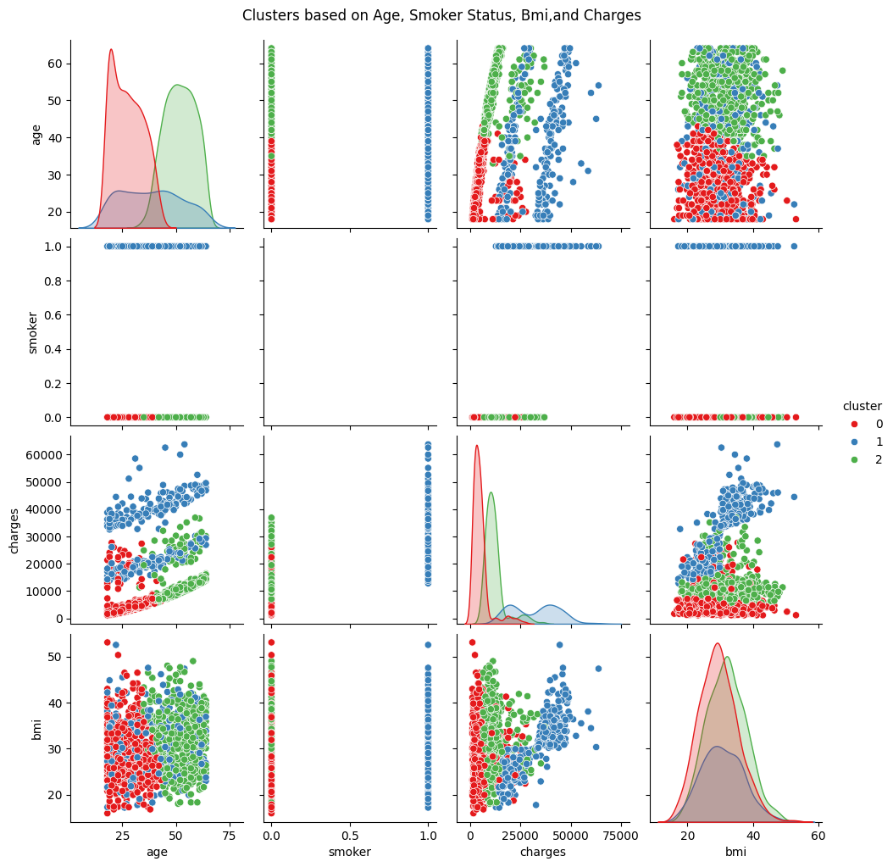

Slide 13
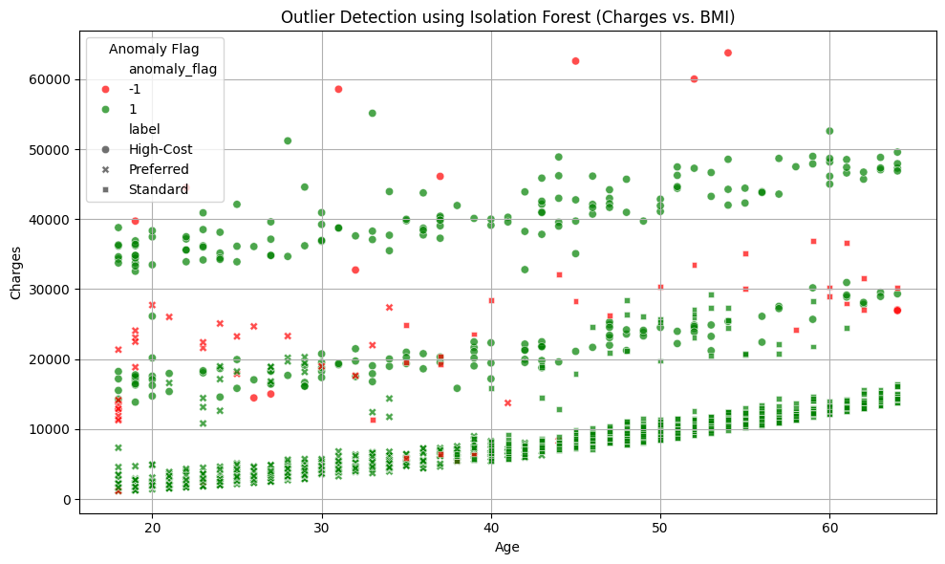

Slide 14
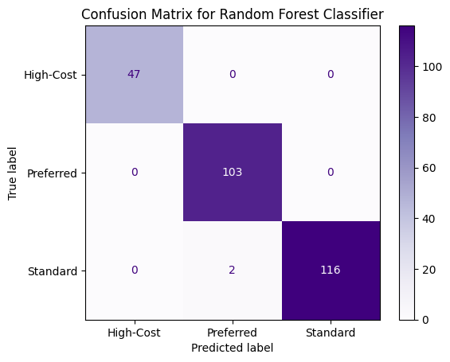

Slide 15
99.25%
&
5%
Accuracy!
Anomalies!

Slide 16
05
Impact & Essential Question
Discuss the impact of the model.

Slide 17
Impact
Positive(s)
Negative(s)
Cost effective and time efficient.
Model accuracy and anomaly detection rate.
Scalability.
Favoritism to Insurers.
Model performance (run time).

Slide 18
Essential Question
In the process of creating Machine Learning solutions for the Health Insurance Industry, our project mitigates bias by using impartial data and ensuring human groups can review the decisions made by the model with Isolation Forests.

Slide 19

06
Wrap Up
Wrap up the project and discuss next steps.

Slide 20
Next Steps
 | Task(s) | Deadline | Assignee
Deployment | Add file upload option. | 8/15/2025 | Sebastian
Scaling | Review data visualizations to determine if feature scaling would be beneficial. | 8/15/2025 | Drexana
Fraud | Dive deeper into fraud detection. | 8/20/2025 | Drexana & Sebastian
Github | Update repository (ie; add diagrams). | 8/21/2025 | Drexana & Sebastian

Slide 21

07
Sources
Our repository and listed sources that aided the project along.

Slide 22
Sources
Github Repository
Streamlit
Exploiting Machine Learning Bias to predict medical denials
Medical Underwriting
Random Forest
Dataset
Forbes Fraud Statistics
Healthcare Expenditures
Linear Regression
Insurance Risk Class
AI in Healthcare Bias & Mitigations
Isolation Forest

Slide 23
Thanks!
DO YOU HAVE ANY QUESTIONS?

Slide 24


